Slide 1
Notes:
This is an Earth Hour-themed assembly designed for a Key Stage 2 or 3 audience to increase their awareness and understanding of Earth Hour, to share what the lastminute.com London Eye is doing to support Earth Hour and help students reflect on how they can get involved and make a difference.
Curriculum links
KS2:
PSHE Education Programme of Study – non-statutory (PSHE Association) - England
Pupils learn ways of carrying out shared responsibilities for protecting the environment in school and at home; how everyday choices can affect the environment (e.g. reducing, reusing, recycling; food choices)
KS3:
Geography – statutory (National Curriculum) - England
Human geography relating to: population and urbanisation; international development; economic activity in the primary, secondary, tertiary and quaternary sectors; and the use of natural resources
Citizenship – statutory (National Curriculum) - England
Pupils should be taught about the roles played by public institutions and voluntary groups in society, and the ways in which citizens work together to improve their communities, including opportunities to participate in school-based activities

Slide 2
Notes:
Ask students to consider the questions on screen.
Depending on delivery style, you could ask students to think silently on their own and put their hands up/cold call, or first discuss with the people around them and then share with you.

Slide 3
Notes:
Additional presenter notes to support the information on screen:
Earth Hour is a global movement that allows us to come together to reflect on what nature means to us. It's our time to switch off from distractions and focus on our world. ​
Earth Hour was designed to show that together we can make small, positive changes to bring our world back to life.
It starts with a single switch. But it’s not just about ‘an hour’. It’s about committing every day to take care of our planet and each other. Earth Hour is a symbol of unity and hope. It is a demonstration of how collective action can benefit the future of our planet.

Slide 4
Notes:
See notes for Slide 3

Slide 5
Notes:
See notes for Slide 3

Slide 6
Notes:
Ask students if they recognise any of the images of buildings - can they name them?

Slide 7
Notes:
Share the Earth Hour facts with the students to provide some context and history.

Slide 8
Notes:
Explain that there will be people all around the world taking part in Earth Hour, including in London.

Slide 9
Notes:
Introduce the concept of ‘boroughs’. Ask students if they know how many boroughs there are in London? And which borough their school is in?

Slide 10
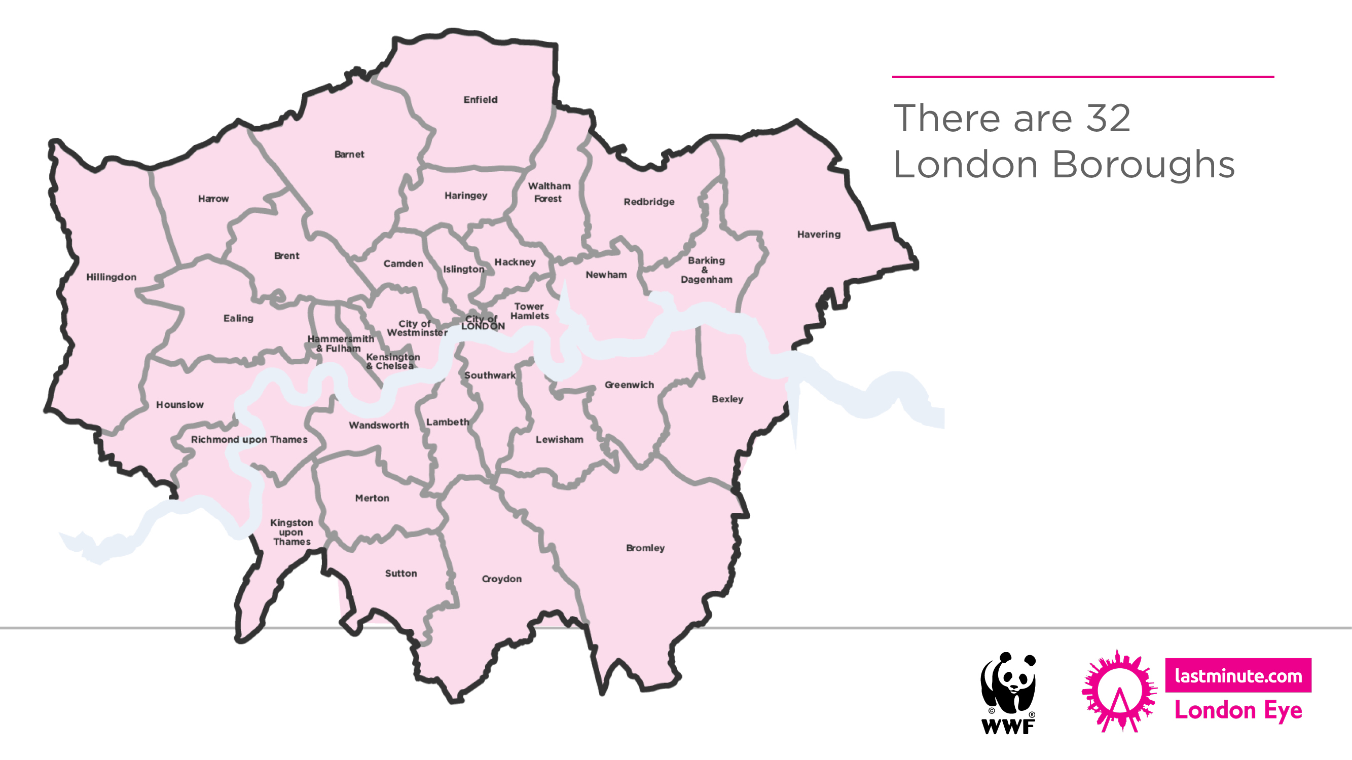
Notes:
Explain there are 32 London boroughs.
Confirm which borough the school is in and share any relevant info specific to their borough. e.g. which boroughs are next to their school’s borough. You can use the on-screen map to support this.

Slide 11
Notes:
Ask students to consider which landmark this could be – either individual reflection or pair discussion, followed by hands up or cold call.

Slide 12
Notes:
Ask students to consider the name of the landmark and where it is.
Give students the opportunity to consider the multiple-choice question – which borough the landmark is in. All answers on next slide.

Slide 13
Notes:
Extra information about the London Eye to support the information on screen:
A newspaper held a competition asking readers to design a landmark for the Millennium. The competition was abandoned with no winner, but architects (and husband and wife) David Marks and Julia Barfield were so passionate about their idea that they decided to pursue it. They wanted to create a structure of beauty that would celebrate London’s creativity and innovation and would provide a new perspective.
The lastminute.com London Eye is often mistakenly called a Ferris wheel. This is not the case for several reasons. Firstly, the pods are completely enclosed and climate controlled; second, the pods are positioned on the outside of the wheel structure and are fully motorised and third, the entire structure is supported by an A-frame on one side only; making it the world’s tallest cantilevered observation wheel.

Slide 14
Notes:
Explain to the students that the lights on the wheel will be switched off for Earth Hour. Images show students the difference between when the lastminute.com London Eye is lit up (image on the left) and when the lights on the wheel were switched off last year for Earth Hour (image on the right).

Slide 15
Notes:
Extra information:
You can see around 40km from the top of the lastminute.com London Eye – on a clear day, you can see as far as Windsor Castle.

Slide 16
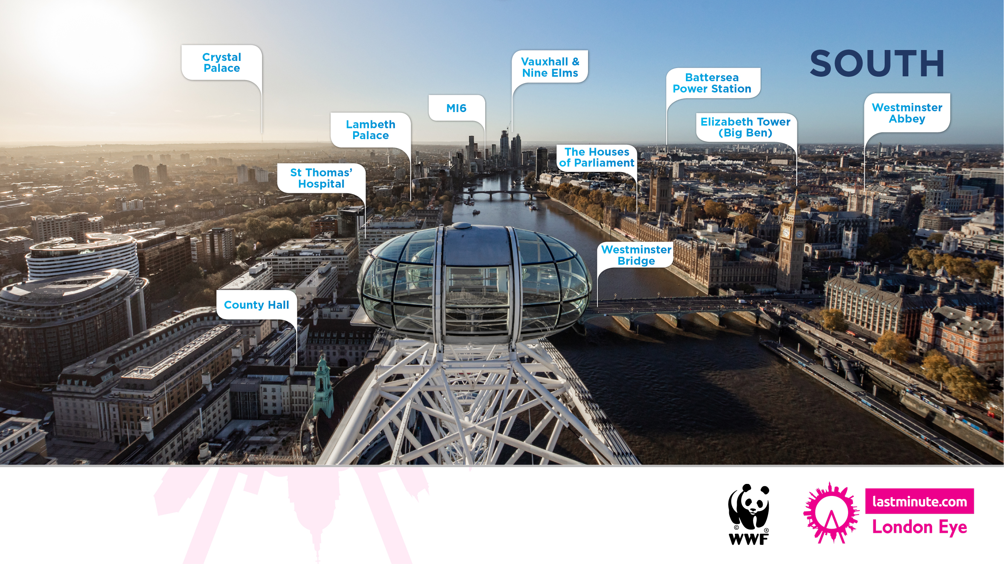
Notes:
South view - Use the image of the view from the lastminute.com London Eye to point out certain landmarks.

Slide 17
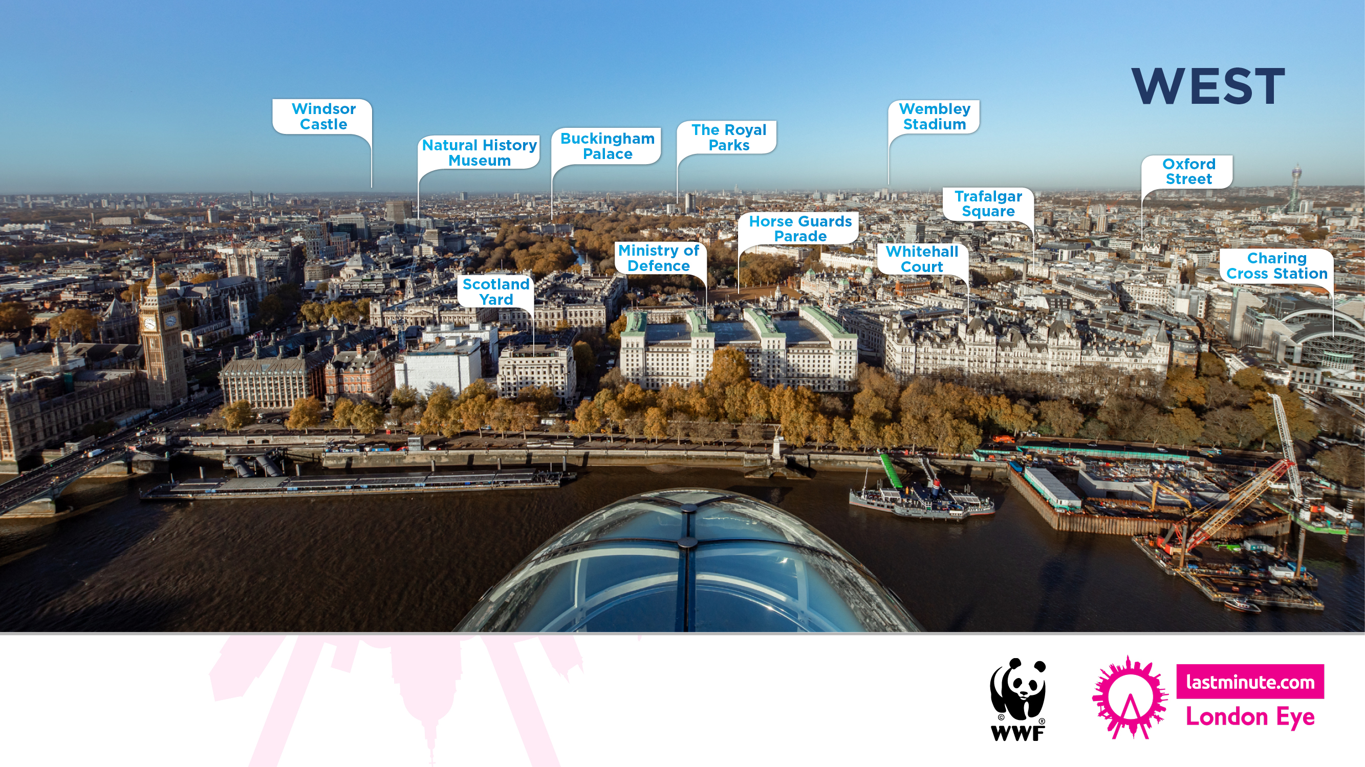
Notes:
West view - Use the image of the view from the lastminute.com London Eye to point out certain landmarks.

Slide 18
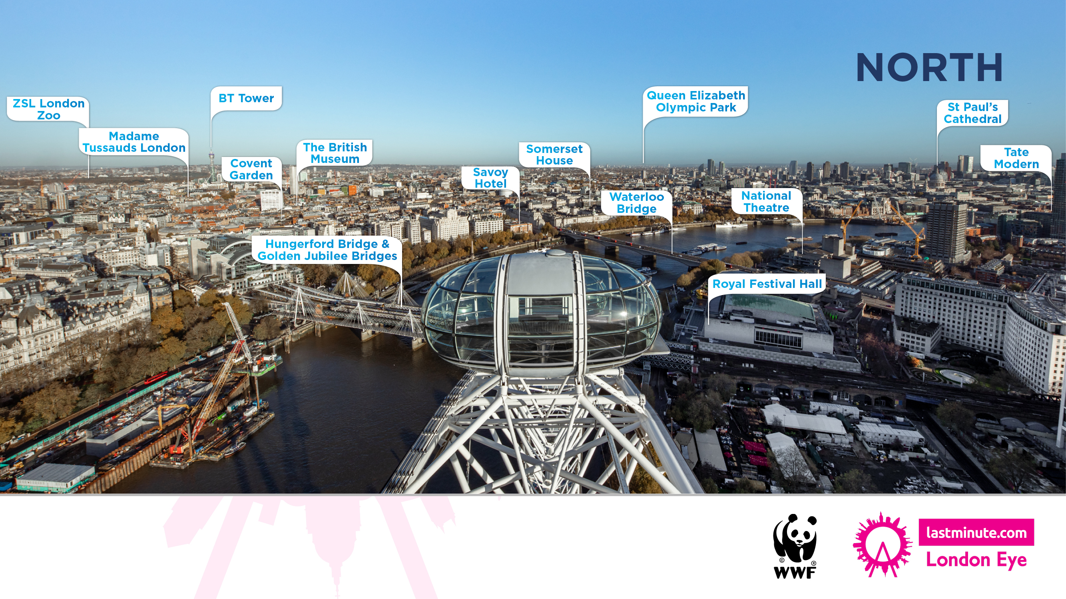
Notes:
North view - Use the image of the view from the lastminute.com London Eye to point out certain landmarks.

Slide 19
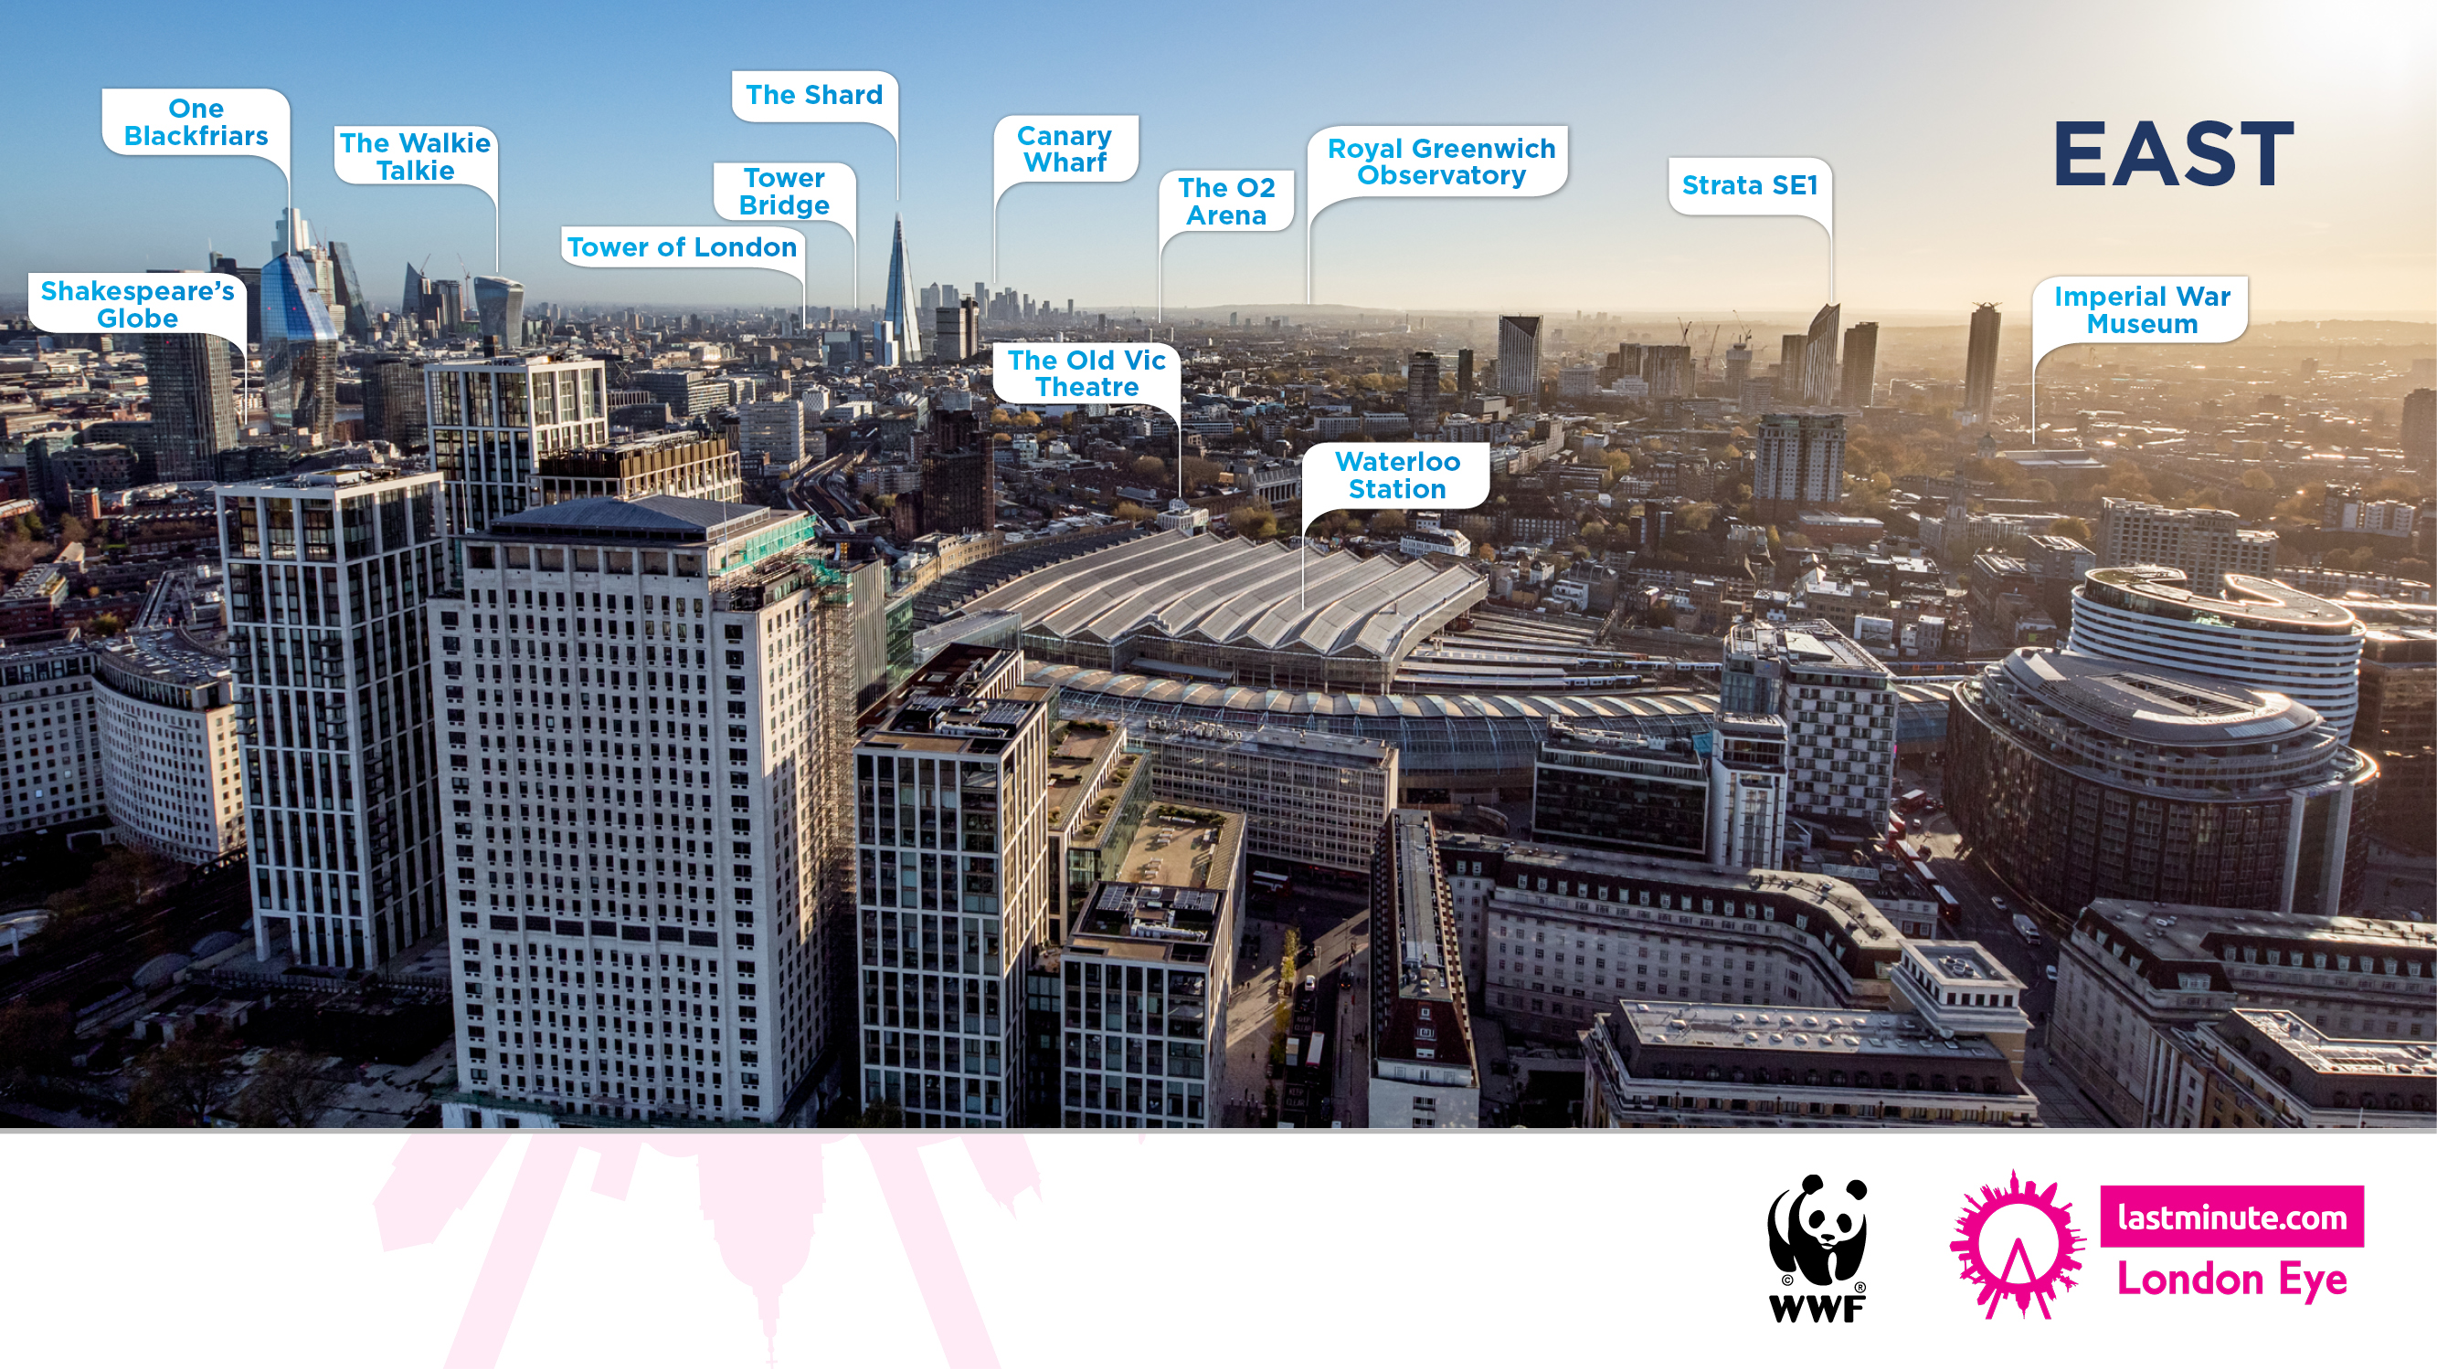
Notes:
East view - Use the image of the view from the lastminute.com London Eye to point out certain landmarks.

Slide 20
Notes:
Encourage students to consider these questions linked to participation in Earth Hour and the impact. Opportunity for students to share their ideas.

Slide 21
Notes:
Remind students of the key date/time and key Earth Hour message

Slide 22
Notes:
Share the suggestions on screen about how students can get involved and make a difference. Leave on screen for students to consider as they wait to leave the assembly.

